Slide 1
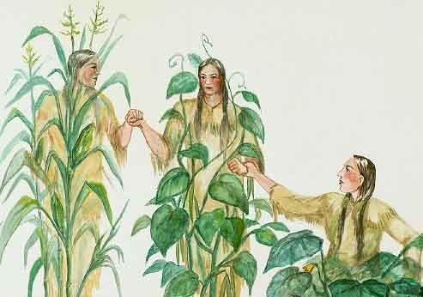
What do you observe?

Slide 2
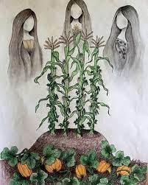
The Three Sisters
“Think of the Three Sisters as the Holy Trinity of some Indigenous cultures, a trifecta of agricultural sustainability, and as the base of a really good soup. The Three Sisters are represented by corn, beans, and squash and they’re an important facet of Indigenous culture and foodways.

Slide 3
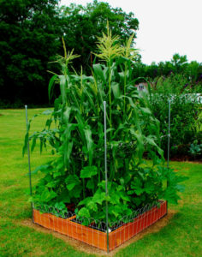
The Three Sisters
They’re planted in a symbiotic triad where beans are planted at the base of the corn stalks. The stalks offer climbing bean vines support as they reach for sunlight from the earth.
The beans, in turn, pump beneficial nitrogen back into the soil, fertilizing the corn and squash, while the squash's broad, spiny leaves protect the bean plants from predatory animals.

Slide 4
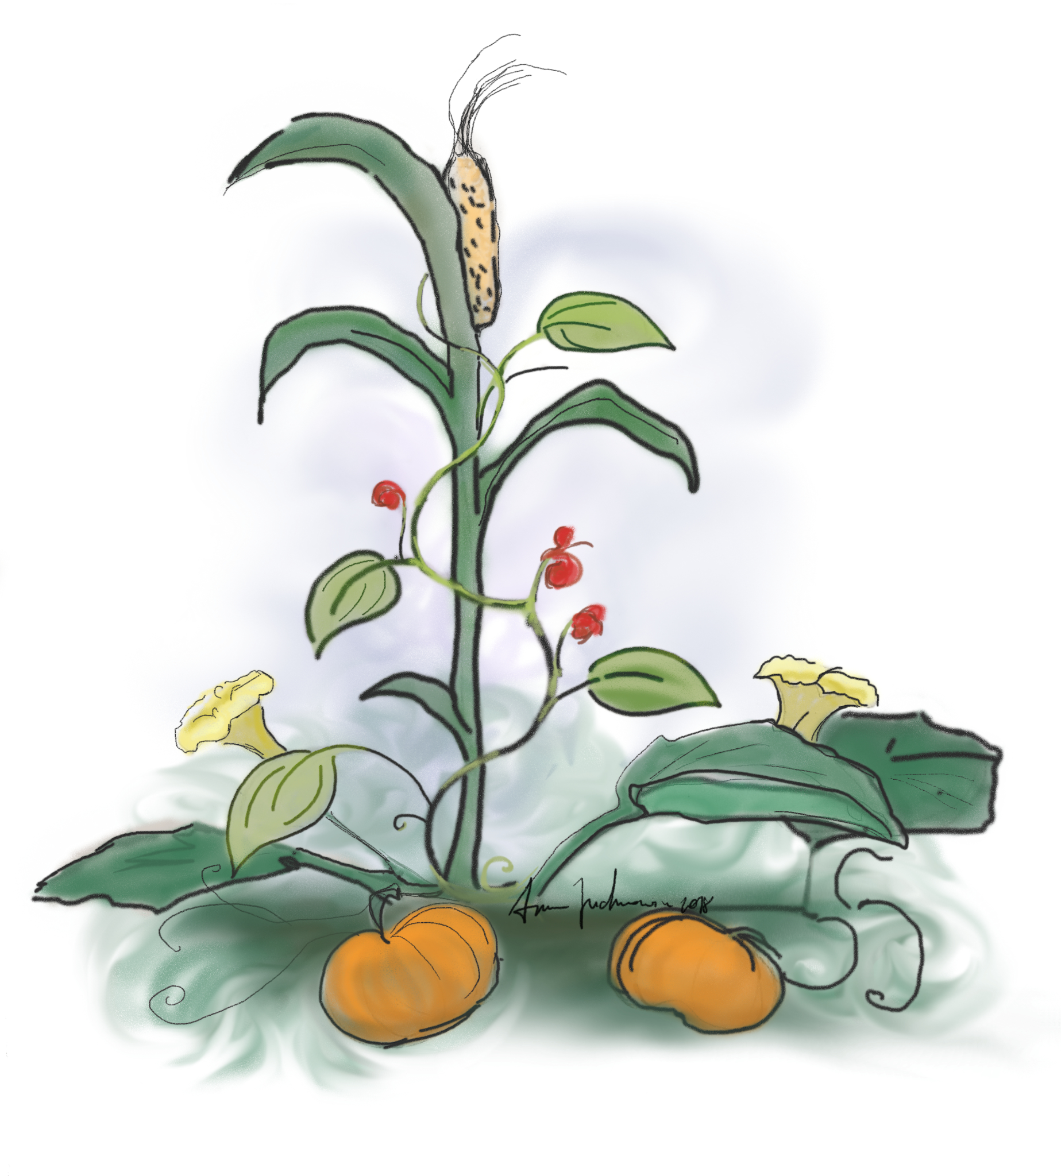
The Three Sisters
The Three Sisters also offer spiritual connection and appear in mythology across tribes, from the Hopis of the Southwest to the Oneidas of the Midwest and the Iroquois in the Northeast....” -- PBS

Slide 5
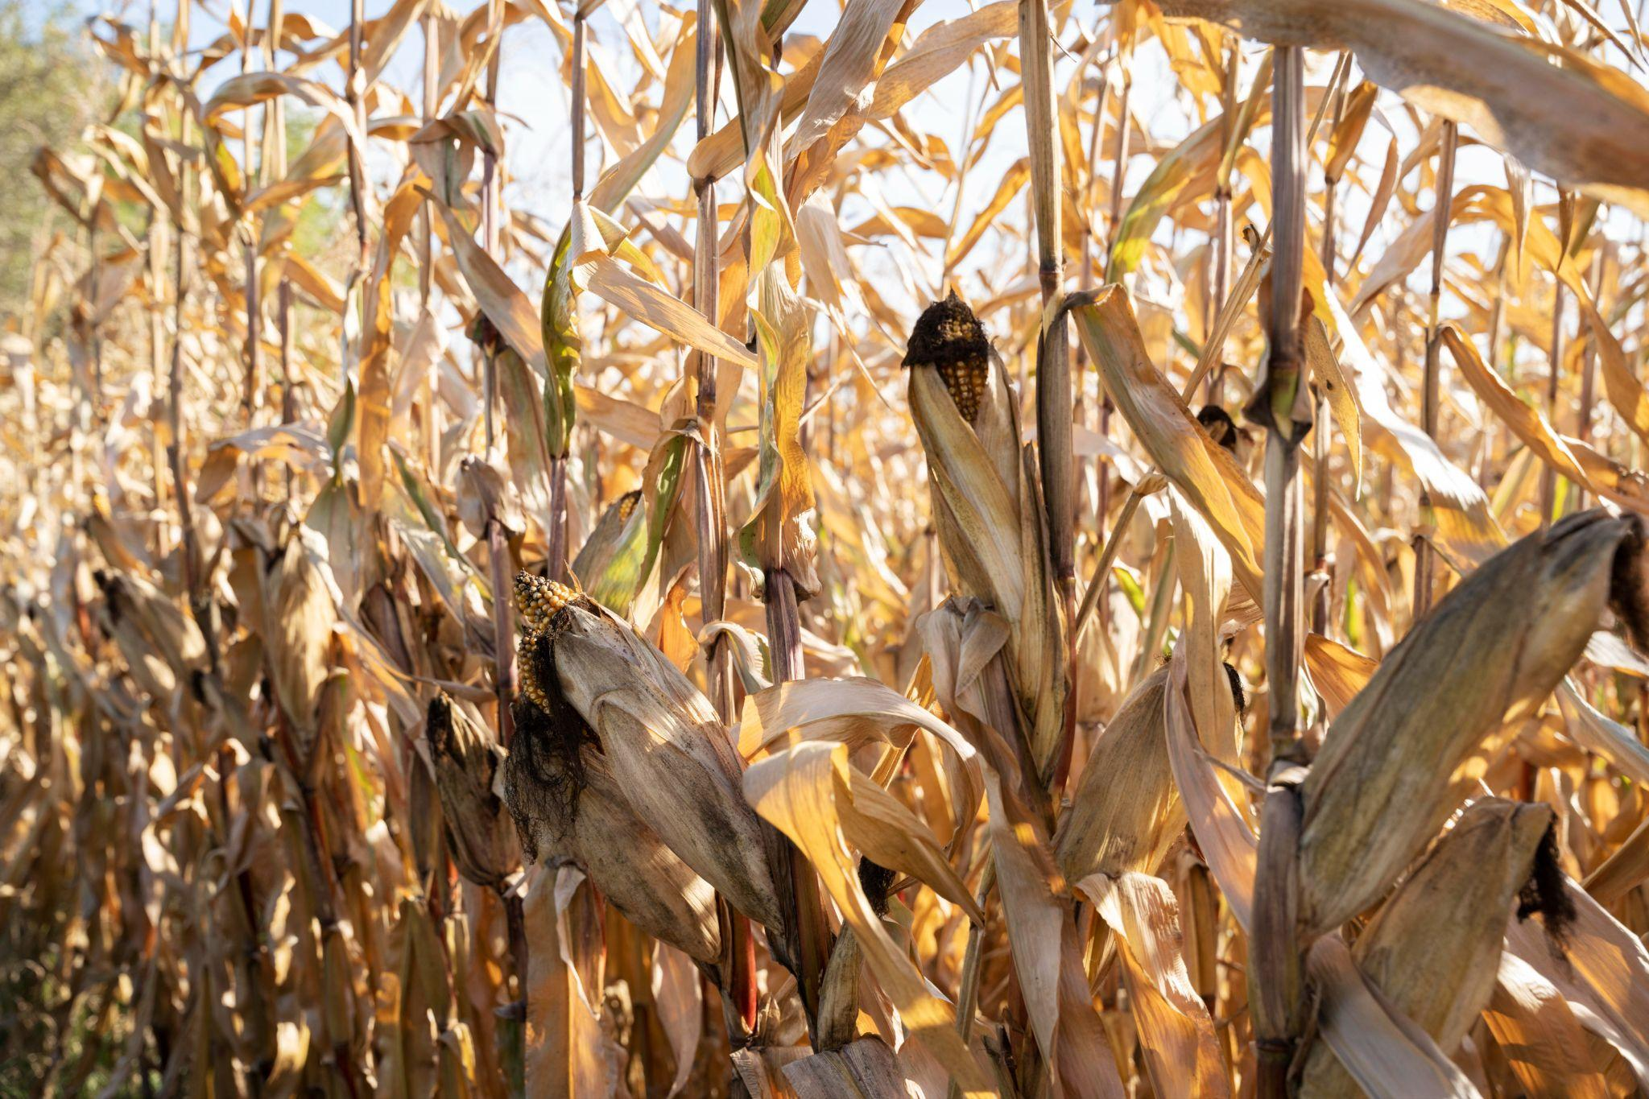
Monoculture “Monoculture/solely crop production farms are the farming types by which farmers grow only crops, both annual crops/trees and field crops, such as wheat, corn, rice, rapeseed, sugar cane, and cotton. Monoculture is widely used in industrial farming systems, including conventional and organic farming, and has allowed increased efficiency in planting and harvest. Continuous monoculture, or “monocropping” where the same species is grown year after year, can lead to unsustainable environments such as building up disease pressure and reducing particular nutrients in the soil. Under certain…”

Slide 6
Monoculture …circumstances, monocropping can lead to deforestation. The practice has also been criticized for its environmental impacts, one of the major being soil degradation due to non rotational cropping. Crop rotation is the practice of changing the types of crops in a farmland from year to year, which improves soil health and quality, whereas monocropping has been implicated in the loss of nutrients from the soil (Bennett et al., 2012).” -- ScienceDirect

Slide 7
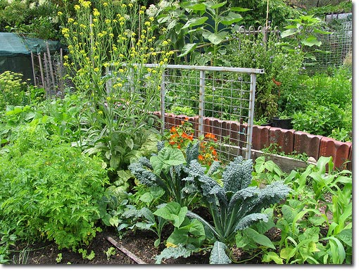
Polyculture “The use of polycultures in agriculture, usually referred to as intercropping, is based on the traditional knowledge that carefully selected mixtures of crops are characterized by higher overall yields. This occurs because of more thorough use of limiting resources (complementarity), lower fertilizer requirements, greater resistance to herbivorous pests, and greater soil stability in polycultures when compared to monocultures. Additionally, growing multiple crops in a field provides farmers with a form of insurance: there is still something to harvest if one crop fails.” -- ScienceDirect

Slide 8
Polyculture “Because of these benefits, intercropping was the primary method of agriculture worldwide throughout most of history. Intercropping remains widespread in developing countries, though it has been largely abandoned in developed countries (e.g., the United States and in Europe) in the latter half of the 20th century due to the industrialization of agriculture. More recently, interest in organic farming techniques and sustainable agriculture has prompted First World farmers to return to this time-tested technique for increasing crop yield without applying chemical fertilizers and pesticides.” -- ScienceDirect

Slide 9
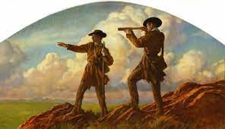
Let’s Revisit Westward Expansion
“The expansion of the United States into the territory west of the Mississippi River began with the Louisiana Purchase in 1803. President Thomas Jefferson nearly doubled the size of the nation by negotiating a price of $15 million to purchase 828,800 square miles from France, including all or part of 14 current states. In 1804, Jefferson sent an expedition led by Meriwether Lewis and William Clark to explore the area. The three-year expedition produced new understanding of the geography and resources of the western part of the continent. In the 1830s and 1840s, “manifest destiny”, the idea that the United States was destined to expand across the entire continent, was used to promote further territorial expansion.” -- Library of Congress

Slide 10
Let’s Revisit Westward Expansion
“States joined the Union at a relatively fast pace: California became a state in 1850 and Oregon in 1859, Nevada in 1864, Nebraska in 1867, Colorado in 1876, South and North Dakota, Montana, and Washington in 1889, Wyoming and Idaho in 1890, and Utah in 1896. As new towns like Denver and Phoenix sprang up in these new states, established towns and cities grew to accommodate the new industries and new populations that westward expansion brought with it.
A number of factors fueled migration west. Trappers, settlers, and miners headed West from the eastern United States prior to the Civil War. The Homestead Act, passed in 1862, allowed settlers to claim 160 acres of land for free. Another important factor was completion of the first transcontinental railroad in 1869; the railroad led to much more rapid western migration and also facilitated economic development.”
-- Library of Congress

Slide 11
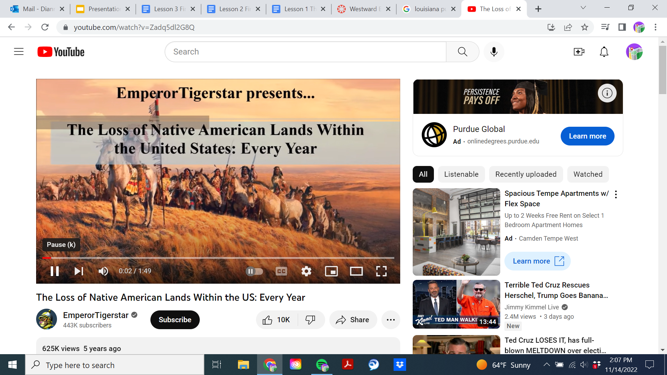
Loss of native land by year beginning 1790

