Slide 1
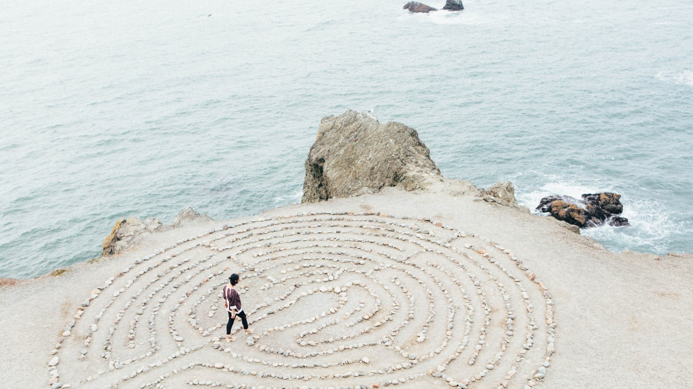
Sacred Places Around the World
Notes:
Photo by Ashley Batz on Unsplash | https://unsplash.com/photos/betmVWGYcLY

Slide 2
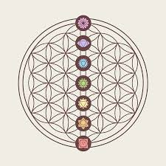
Essential Questions
What are sacred places?
What makes indigenous sacred places unique?

Slide 3
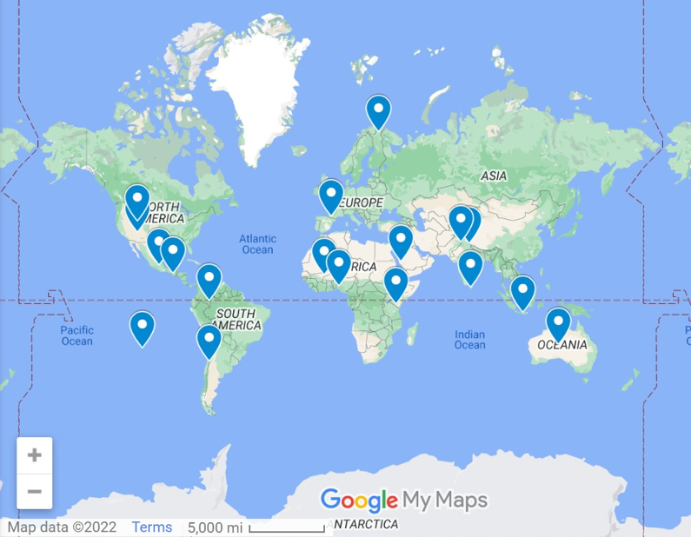
Map of Selected Sacred Places
Notes:
Open this map up before the presentation – put in tab
Created by Frances Coffey using Google My Maps – Found in your Google Drive Suite

Slide 4
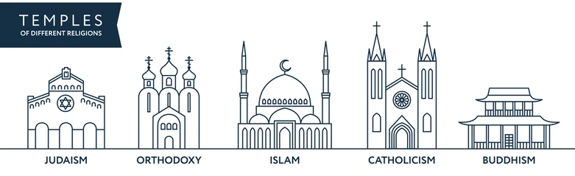
sacred place: a location that is
considered holy or spiritual
Notes:
Photo: https://image.shutterstock.com/image-vector/temples-world-different-religions-infographics-260nw-518053699.jpg

Slide 5
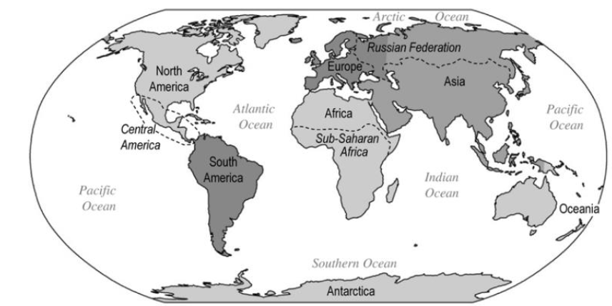
World Regions

Slide 6
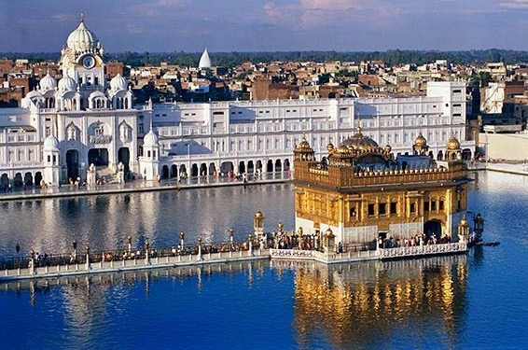
Golden Temple in India
The Golden Temple in India is the most sacred place in Sikhism. The building has entrances on all four sides, indicating that it is open to people of all religions. Inside the temple, on a jewel-studded platform, lies the Guru Granth Sahib, the central holy religious scripture of Sikhism.
The lake surrounding the Golden Temple is known as Amrit Sarovar which means “pool of ambrosial nectar.” Sikhs consider the pool holy and purifying. Many bathe in it from the outer platform. Thousands of Sikhs visit this shrine daily for worship.
Notes:
Photo: https://sacredsites.com/images/asia/india/golden_temple_600.jpg

Slide 7
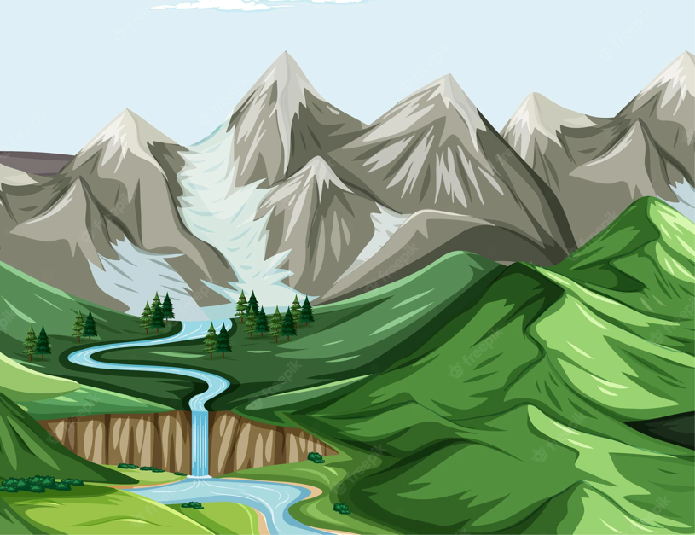
physical landscape: the natural environment
Notes:
Photo: https://img.freepik.com/free-vector/nature-geographic-landscape-vector_1308-61300.jpg?w=2000

Slide 8
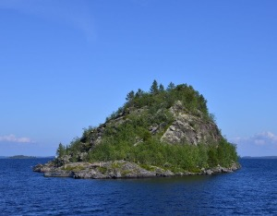
Ukonsaari Island in Finland
The island of Ukonsaari in Lake Inari in northern Finland is a sacred place to the indigenous Sámi people. The Sámi have lived near the rocky island for two thousand years. Steep cliffs and a cave characterize the physical landscape. The island is closely connected to the Sámi’s worship of their god of thunder, Ukko, who was the most important male deity.
Notes:
Photo: https://www.worldheritagesite.org/picx/t221.jpg

Slide 9
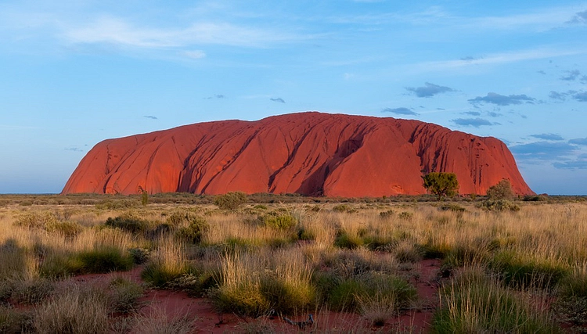
Uluru in Australia
Uluru is a sacred place to the indigenous Aṉangu people who have lived in this area for more than 30,000 years. The physical landscape is characterized by this large sandstone formation, which reaches more than 2,800 feet above sea level.
The Aṉangu people believe that the Uluru was formed during the Dreaming, a time when the land and people were created by the ancestor spirits. The Aṉangu conduct ceremonies today in the sacred caves at the base of Uluru.
Notes:
Photo: https://www.worldhistory.org/img/r/p/500x600/10131.jpg.webp?v=1635275703

Slide 10
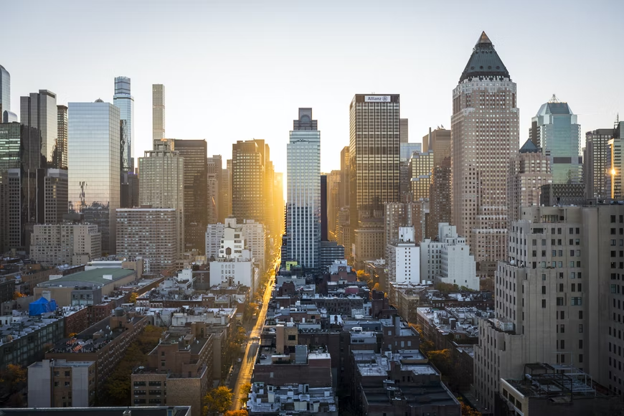
built environment: the human-made environment consisting of structures
Notes:
Photo: https://images.unsplash.com/photo-1480714378408-67cf0d13bc1b?ixlib=rb-1.2.1&ixid=MnwxMjA3fDB8MHxwaG90by1wYWdlfHx8fGVufDB8fHx8&auto=format&fit=crop&w=870&q=80

Slide 11
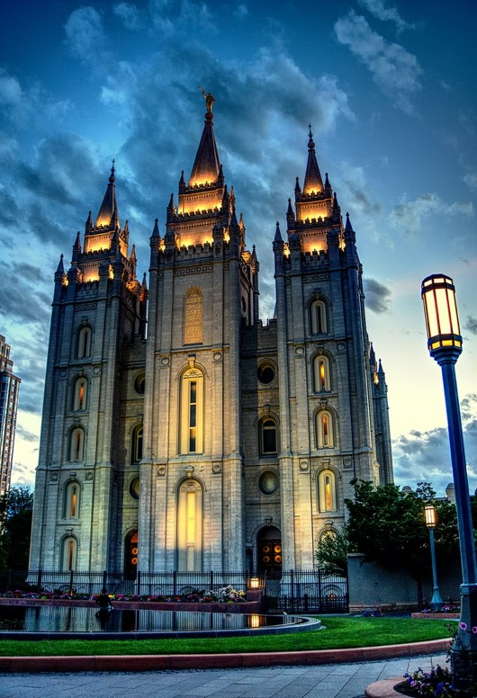
Salt Lake Temple in Utah
Utah’s built environment includes the Salt Lake Temple constructed by The Church of Jesus Christ of Latter-day Saints. Church members consider the temple sacred and a temple recommend is required to enter. Members of The Church of Jesus Christ of Latter-day Saints (Mormons) viewed the building of the temple as a fulfillment of the prophet Isaiah's prophecy. The castle-like battlements surrounding the temple symbolize a separation from the world as well as a protection of the holy ordinances practiced within its walls.
Notes:
Photo: https://unsplash.com/photos/A_6zLzStUww

Slide 12
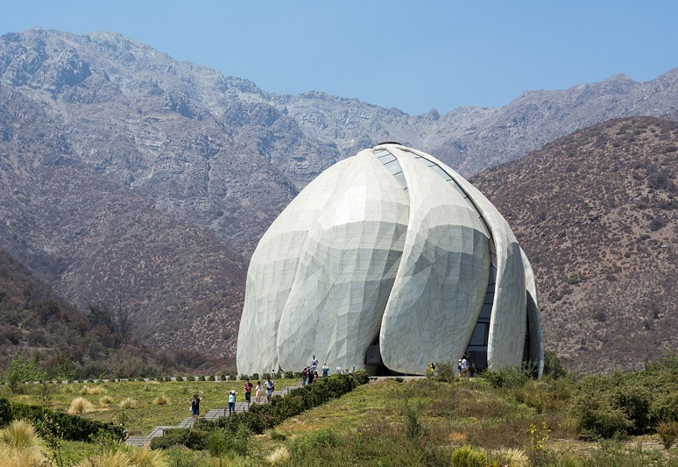
Baháʼí House of Worship
in Chile
Chile’s built environment includes this house of worship that was built for members of the Baháʼí faith. Like all Baháʼí houses of worship, it is open to practitioners of all religions. The sacred writings of the Baháʼí faith as well as other religions can be read and/or chanted inside. One of the main purposes of this Bahá’í Temple is to promote unity by gathering together people of all backgrounds in fellowship, worship, and service.
Notes:
Photo: https://upload.wikimedia.org/wikipedia/commons/thumb/7/75/Templo_Bah%C3%A1%27%C3%AD_de_Sudam%C3%A9rica%2C_Santiago_20200208_04.jpg/1280px-Templo_Bah%C3%A1%27%C3%AD_de_Sudam%C3%A9rica%2C_Santiago_20200208_04.jpg

Slide 13
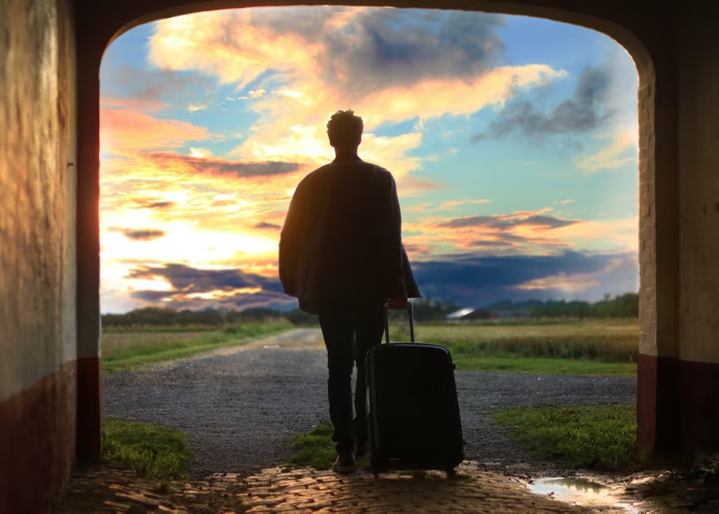
pilgrimage: a journey to a sacred place for spiritual reasons
Notes:
Photo: https://images.unsplash.com/photo-1473625247510-8ceb1760943f?ixlib=rb-1.2.1&ixid=MnwxMjA3fDB8MHxwaG90by1wYWdlfHx8fGVufDB8fHx8&auto=format&fit=crop&w=811&q=80

Slide 14
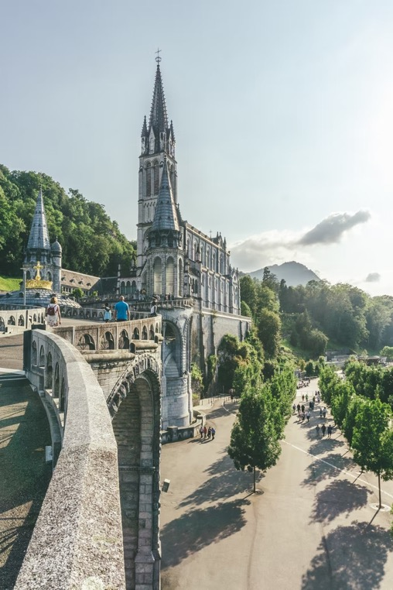
Lourdes in France
The Sanctuary of Our Lady of Lourdes is an important pilgrimage site for Roman Catholics. It is the largest healing shrine in Christendom. Millions of sick pilgrims travel to Lourdes due to the reported healing powers of its water. People who cannot make the pilgrimage may send for healing waters for use in their own homes or request prayers to be said.
Notes:
Photo: https://unsplash.com/photos/f0VFalfT_xs

Slide 15
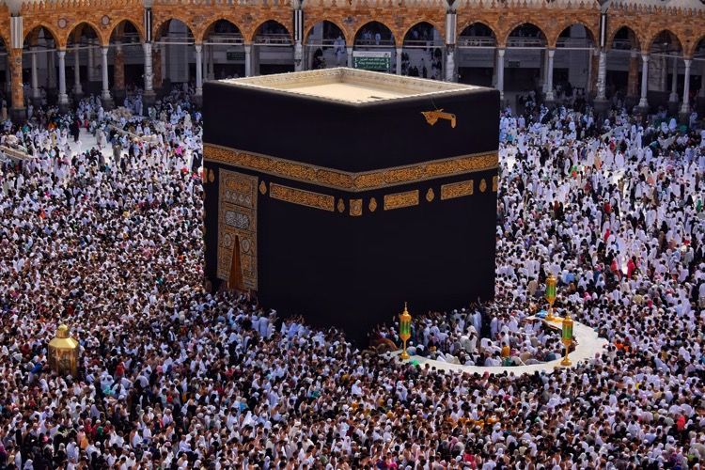
Kaaba in Saudi Arabia
The Kaaba is the most sacred place in Islam. It is the cubic stone building in the Court of the Great Mosque of Mecca. Muslims face in the direction of the Kaaba when praying five times a day.
Muslims are supposed to make a pilgrimage to the Kaaba in Mecca at least once in their lifetime. Muslims regard the Kaaba as a holy site, believing that the Prophet Abraham and his son, Ishmael raised the foundations of the Kaaba.
Notes:
Photo: https://unsplash.com/photos/8Kg-2kK97Xc?utm_source=unsplash&utm_medium=referral&utm_content=creditShareLink

Slide 16
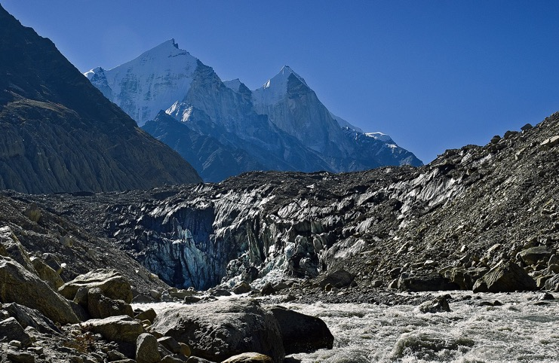
Gangotri Glacier in India
The Gangotri Glacier in India is a pilgrimage site for Hindus. Hindu pilgrims engage in the holy ritual of bathing in the glacier’s icy waters to wash away sin and ensure eternal happiness. The holy Ganges River originates from the Gangotri Glacier. Hindu scriptures teach that the waters of the Ganges purifies the soul, while ancient myths claim that the Ganges River is the embodiment of the goddess Ganga. Due to its sacred status, people who live along the banks of the river share a strong spiritual connection.
Notes:
Asia: Gangotri Glacier - Source of the holy Ganges River
Photo: https://upload.wikimedia.org/wikipedia/commons/thumb/d/db/Gomukh_the_source_of_Ganga.jpg/1600px-Gomukh_the_source_of_Ganga.jpg?20160612160416

Slide 17
indigenous people: original inhabitants of the land
Notes:
Photo: https://www.verywellmind.com/thmb/lCPrYJuDvViT40oJJNJk_n7hjS0=/800x0/filters:no_upscale():max_bytes(150000):strip_icc():format(webp)/what-are-indigenous-populations-5083698-FINAL-eeea1361b27d4235b0a05bc346982252.png

Slide 18
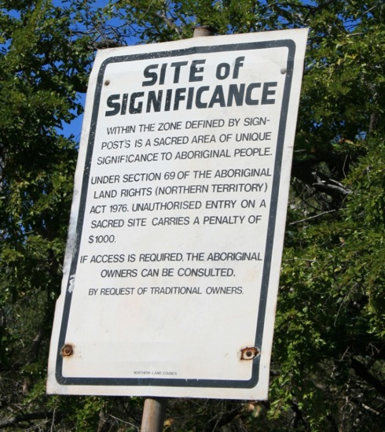
indigenous sacred place: a location that is considered holy or spiritual by the original inhabitants of the land
Notes:
Photo: https://sacrednaturalsites.org/wp-content/uploads/2012/03/pic-3-Signage-at-Yalanbara.jpg

Slide 19
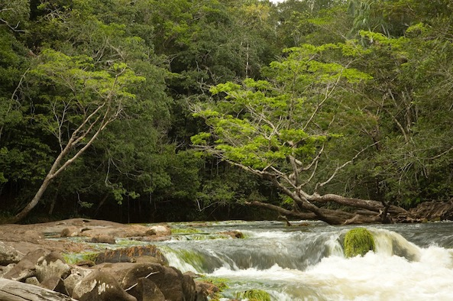
Pirá Paraná River in Colombia
The Pirá Paraná River is home to 2,000 indigenous people belonging to seven different ethnic communities. The Pirá Paraná River forms the heart of an indigenous sacred place called Hee Yaia Godo ~Bakari (territory of the Jaguar Shamans of Yuruparí). The indigenous people of this area stated, “This great Yuruparí territory is also like a human body that breathes, feels and has organs that enable it to function and live. The organs of this territory are places that we consider sacred; they are places that contain vital and spiritual energy that nurtures all living beings in the surroundings.”
Notes:
Photo: https://sacredland.org/wp-content/uploads/2018/09/Pira-Pirana.jpg

Slide 20
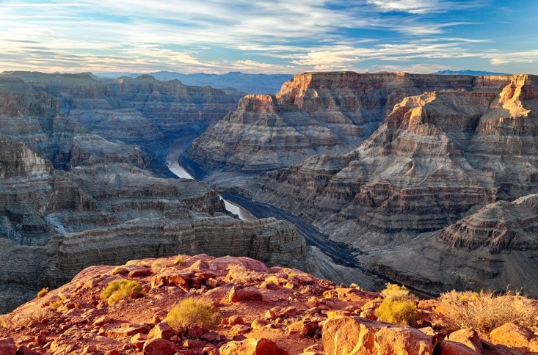
Grand Canyon in Arizona
For at least 4,000 years, indigenous people like the Havasupai, Hopi, and Navajo have thrived in the Grand Canyon. According to Hopi tradition, their ancestors emerged into the canyon through an underground cave and still reside there. The Hopi believe it is their duty to protect the indigenous sacred place. The Navajo also believe that the Grand Canyon must be protected to avoid offending the Kachinas, ancestral spirits of the mountain.
Notes:
Photo: https://unsplash.com/photos/ZZnH4GOzDgc

Slide 21
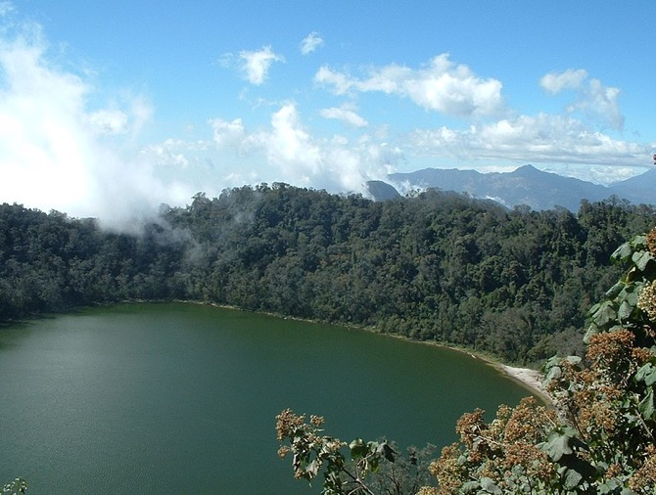
Chicabal Lake in Guatemala
Surrounded by the cloud forest, Chicabal Lake is sacred to the indigenous Mam Mayan people. Mam spiritual leaders have held ceremonies at this indigenous sacred place for thousands of years, believing the lake is a route from the human world to the underworld. Only the Mam can visit Chicabal in early May so that they may practice religious ceremonies without disturbance. Part of the built environment includes altars surrounding the lake, which offer different places for blessings like better health or fertility.
Notes:
Photo: https://upload.wikimedia.org/wikipedia/commons/thumb/4/47/Laguna_Chicabal2.jpg/264px-Laguna_Chicabal2.jpg

Slide 22
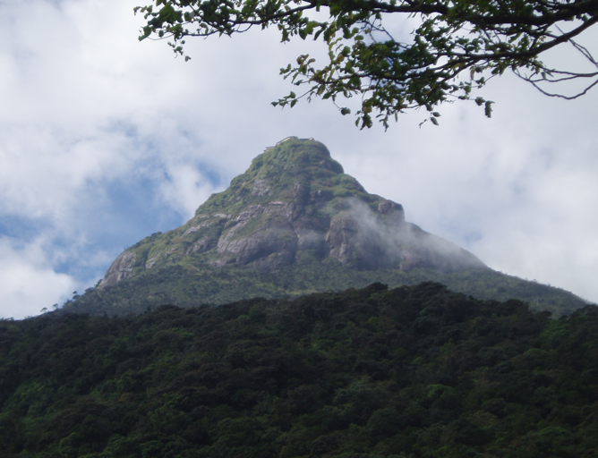
Sri Pada in Sri Lanka
Sri Pada is a mountain that the indigenous Sri Lankan people, the Veddas, can claim direct descent from the aboriginal community who lived here for thousands of years. The Veddas believe the mountain is home to one of the island’s guardian spirits.
This sacred place is also important in Buddhism and Hinduism. Hindus believe that the god Shiva created the world through dance at Sri Pada. Buddhists make pilgrimages here to see the footprint believed to be left by Buddha.
Notes:
Photo: https://upload.wikimedia.org/wikipedia/commons/thumb/a/a2/Sri_Pada.JPG/800px-Sri_Pada.JPG

Slide 23
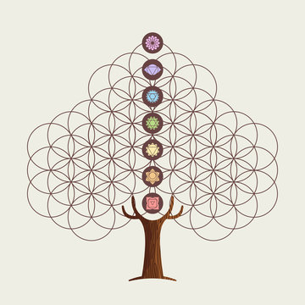
Now, you decide! Which of the following sacred places are examples of indigenous sacred places?

Slide 24
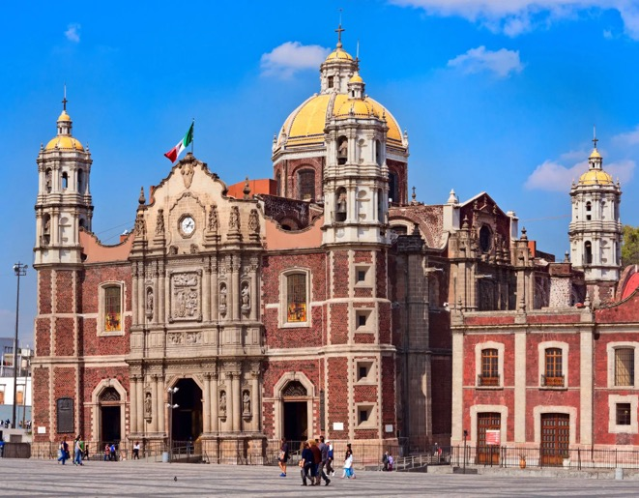
Basilica of the Virgin of Guadalupe in Mexico
The Basilica of the Virgin of Guadalupe is one the world’s most visited Catholic pilgrimage sites. It is devoted to Our Lady of Guadalupe, who was named the Patron of Latin America in 1945. The church was built close to a hill where the Virgin Mary is said to have appeared to Saint Juan Diego in 1531, emblazoning his cloak with an image that is still displayed in the Basilica today.
The image of Guadalupe is a key patriotic symbol in Mexico and she is reportedly a powerful miracle worker.
Notes:
Photo: https://encrypted-tbn0.gstatic.com/images?q=tbn:ANd9GcTm3RjiXETL2vlTPdCEbhDKlEDzgmeB_JcA6dN1ViVRzu9_Ipn7DADJVV0Co0Zx5OzOmjg:https://cdn.britannica.com/79/84879-050-D5AF643B/Old-Basilica-of-Guadalupe-Mexico-Our-Lady.jpg&usqp=CAU

Slide 25
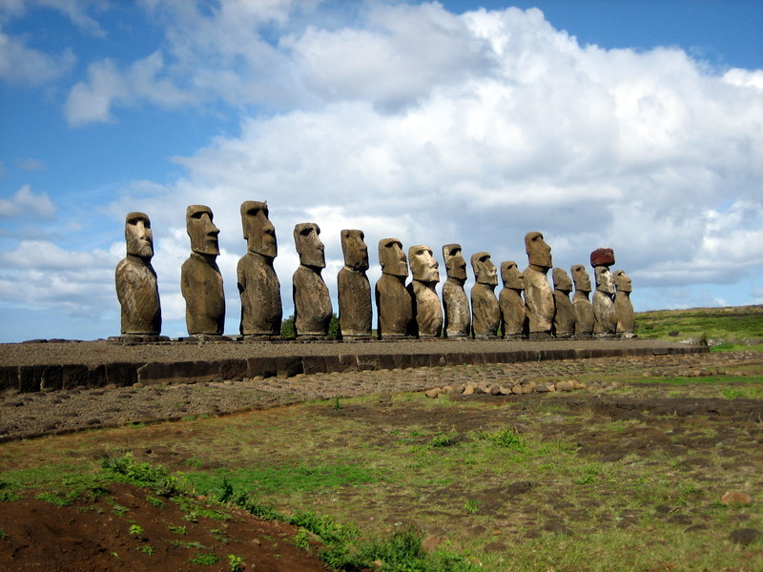
Mo’ai Statues in Easter Island
Easter Island in the South Pacific Ocean is dotted with more than 1,000 monumental statues called mo’ai built by the native Rapa Nui people. These mo’ai are sacred to the Rapa Nui, who believe that they are a source of power and spiritual energy. Archaeologists believe that the statues represent the spirits of ancestors, chiefs, or other high-ranking males of Easter Island.
Notes:
Photo: https://www.worldhistory.org/img/r/p/750x750/13298.jpg.webp?v=1610850043

Slide 26
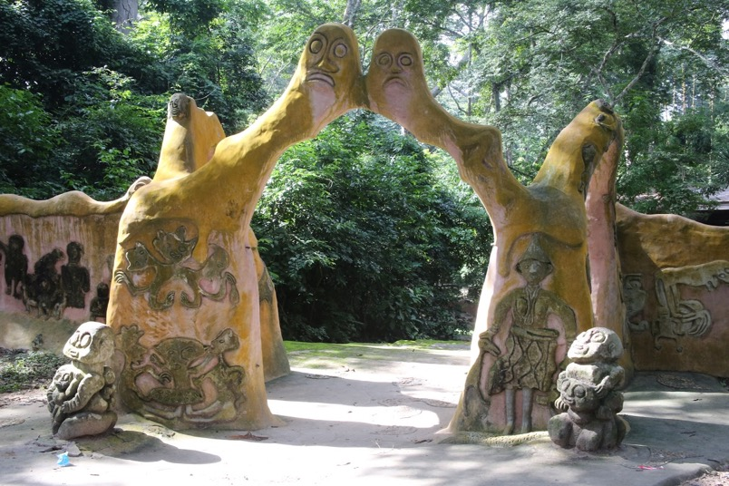
Osun-Osogbo Sacred Grove in Nigeria
The Osun-Osogbo Sacred Grove is sacred to the Yoruba people of Nigeria, who believe that it is the home of the fertility goddess. The grove includes sanctuaries and shrines dedicated to many deities. The Grove is an active religious site, where members of the Yoruba ethnic group pray daily, weekly, and monthly. The Grove is also home to annual processional festivals.
Notes:
Photo: https://lh3.googleusercontent.com/ci/ACqFvF0pPlUnQabe2cbV-uTq5NqNEOjM2KFJyOTbxjUacidBu_HOAw6pjbob6YzAa4FgoBEEa7-borOo=s1200

Slide 27
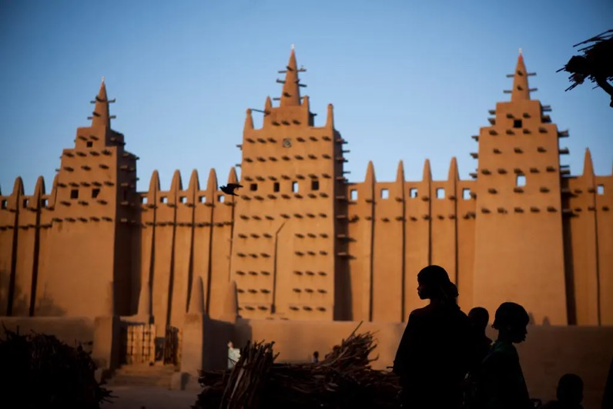
Great Mosque of Djenné in Mali
The Great Mosque in Mali was an important Islamic learning center, attracting thousands of pilgrims and students to study the Quran, the holy book of Islam. The mosque forms part of Mali’s unique built environment. The mosque is made almost entirely of sun-dried mud bricks coated with clay. Citizens of Djenné participate in an annual festival event to replaster the walls of the Great Mosque.
Notes:
Photo:
https://static01.nyt.com/images/2012/04/18/arts/18djenne_cap/18djenne_cap-jumbo.jpg?quality=75&auto=webp

Slide 28
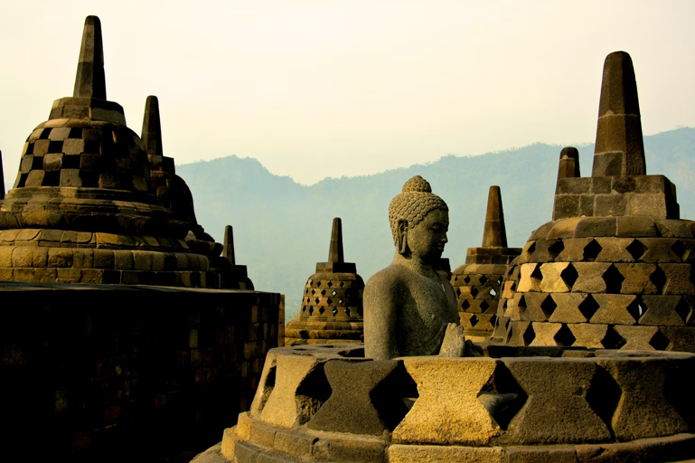
Borobudur Temple in Indonesia
Borobudur is the largest Buddhist temple in the world, built in the 9th century. It has nine stacked platforms, topped by a central dome surrounded by 72 Buddha statues seated inside individual stupas. The monument is a pilgrimage site for Buddhists who start at the base and follow a circular path ascending stairways to the top. The path symbolizes the Buddhist concept of attaining nirvana.
Notes:
Photo: https://images.unsplash.com/photo-1620549146396-9024d914cd99?ixlib=rb-1.2.1&ixid=MnwxMjA3fDB8MHxwaG90by1wYWdlfHx8fGVufDB8fHx8&auto=format&fit=crop&w=1471&q=80

Slide 29
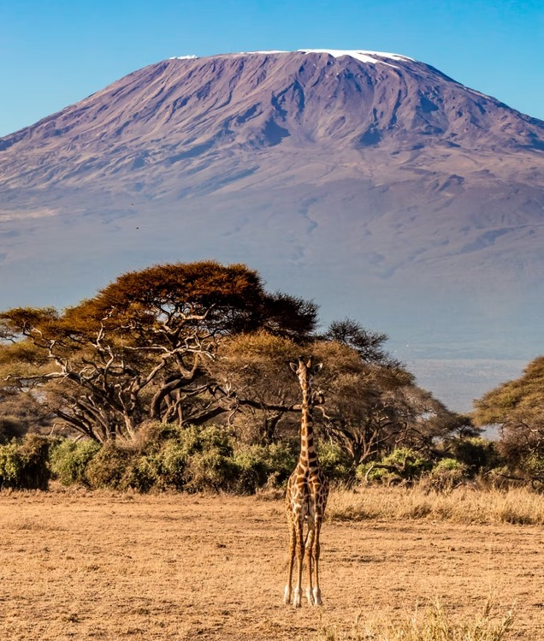
Mount Kilimanjaro in Tanzania
Mount Kilimanjaro in Tanzania is a sacred place to the Chaga, the country’s third largest ethnic group. They believe that the mountain is a sacred place where their gods reside. Their faith holds that Ruwa, the community’s chief god, lives on the top of Mount Kilimanjaro. Shrines in some parts of the high forest are made of masale, which is considered a sacred plant.
Notes:
Photo: https://images.unsplash.com/photo-1631646109248-a7264aae1790?ixlib=rb-1.2.1&ixid=MnwxMjA3fDB8MHxwaG90by1wYWdlfHx8fGVufDB8fHx8&auto=format&fit=crop&w=687&q=80

Slide 30
Sense of place: the subjective perceptions, memories, and personal connections evoked by a geographic location
Notes:
Photo: https://www.familyeducation.com/sites/default/files/inline-images/Feelings%20Flashcards.jpg

Slide 31
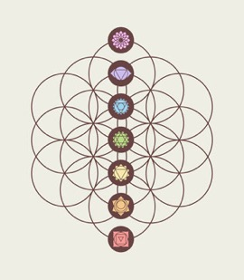
Sense of place Reflection
Reflect about a place that you may consider sacred.
Identify and describe the place.
Is it an indigenous sacred place or a
non-indigenous sacred place?
What is your sense of place when you’re there?
In other words, when you are there, what personal
connections do you experience and why?
If you’re comfortable,
share with a person in the class.

