Slide 1
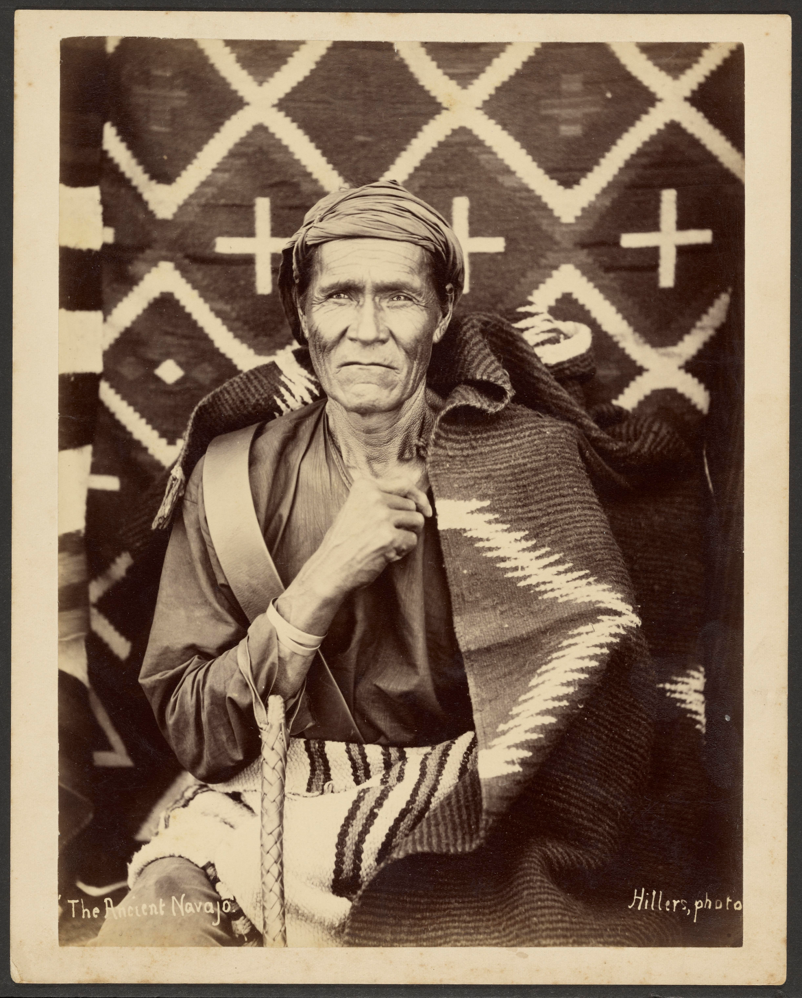
The Navajo Diné Long Walk (1863-1866)
Analyzing Primary and Secondary Sources
Notes:
Photo: “The Ancient Navajo,” by John K. Hillers, 1879
https://www.lookandlearn.com/history-images/YG0040336/The-Ancient-Navajo

Slide 2
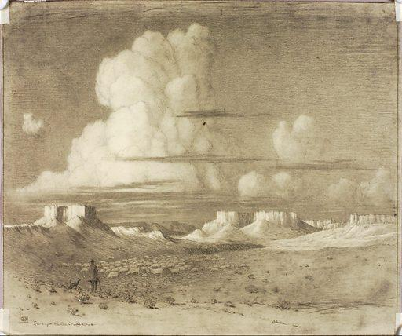
Directions
You will now analyze eight primary and secondary sources about the Navajo Long Walk and the internment at Bosque Redondo.
As you read, consider the following question: In what ways did the Long Walk impact the Navajo people?

Slide 3
Source #1
“There is to be no other alternative but this: say to them [the Navajo], ‘Go to the Bosque Redondo, or will pursue and destroy you. We will not make peace with you on any other terms. You have deceived us too often, and robbed and murdered our people too long, to trust you again at large in your own country. This war shall be pursued against you if it takes years, now that we have begun, until you cease to exist or move. There can be no other talk on the subject.’”
Order given by Brigadier General James Carleton to Colonel Christopher “Kit” Carson
Notes:
Source: https://ehistory.osu.edu/books/official-records/041/0728
Excerpt from: The War of the Rebellion: A Compilation of the Official Records of the Union and Confederate Armies, Serial 041, page 0728, W. Fla., S. Ala., S. Miss., LA., Tex., N. Mex., Chapter XXXVIII

Slide 4
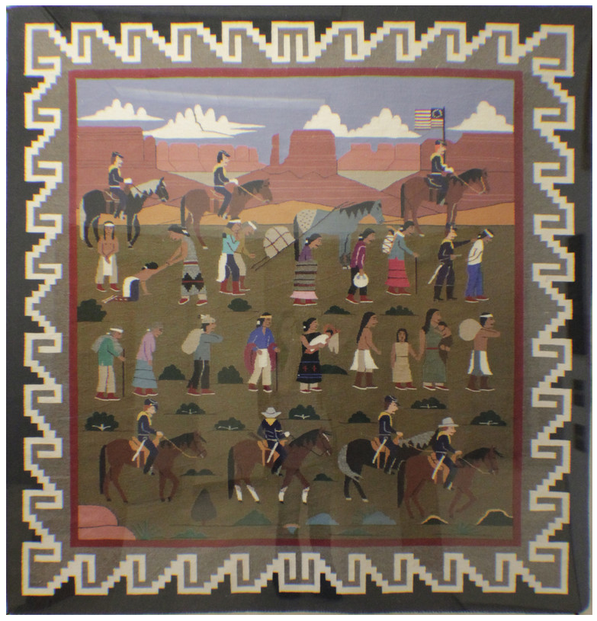
Source #2:
Weaving depicting the “Long Walk” by Master Weaver Linda Nez
Notes:
Source: https://nmhistoricsites.org/bosque-redondo/photo-gallery | Image 28

Slide 5
Source #3
When we crossed the Rio Grande, many people drowned. We didn't know how to swim - there was hardly any water deep enough to swim in at home. Some babies, children, and some of the older men and women were swept away by the river current. We must not ever forget their screams and the last we saw of them - hands, a leg, or strands of hair floating.
There were many who died on the way to Hwééldi. All the way we told each other, "We will be strong, as long as we are together." I think that was what kept us alive. We believed in ourselves and the old stories that the holy people had given us. "This is why," she would say to us. "This is why we are here.”
"In 1864" by Luci Tapahonso, Navajo Nation Inaugural Poet Laureate
Notes:
To hear Luci Tapahonso reciting the poem “In 1864” https://nmhistoricsites.org/bosque-redondo/in-1864
To read the FULL Poem “In 1864” http://www.hanksville.org/storytellers/luci/poems/1864.html

Slide 6
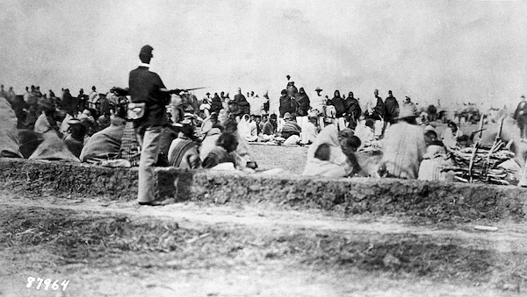
Source #4
Gathering of Native Americans at Fort Sumner, New Mexico,
circa 1864-1868, William A. Keleher Collection
Notes:
Source: Gathering of Native Americans at Fort Sumner, New Mexico, circa 1863-1867, William A. Keleher Collection,
https://econtent.unm.edu/digital/collection/keleher/id/726/rec/481

Slide 7
Source #5
“That place at Fort Sumner was what is now called a concentration camp. There was nothing for us except misery and hunger. There were no pines, no streams except the Pecos, and no game. There was no water fit for drinking. We had been accustomed to the clear, cold water from the melting snow of the White Mountain [Sierra Blanca]. We had to drink the muddy, ill-tasting water from the Pecos. It made us sick; it even made the horses sick. But can one live without water?”
- Big Mouth
Ndé (Mescalero Apache Leader)
Notes:
To hear Luci Tapahonso reciting the poem “In 1864” https://nmhistoricsites.org/bosque-redondo/in-1864
To read the FULL Poem “In 1864” http://www.hanksville.org/storytellers/luci/poems/1864.html

Slide 8
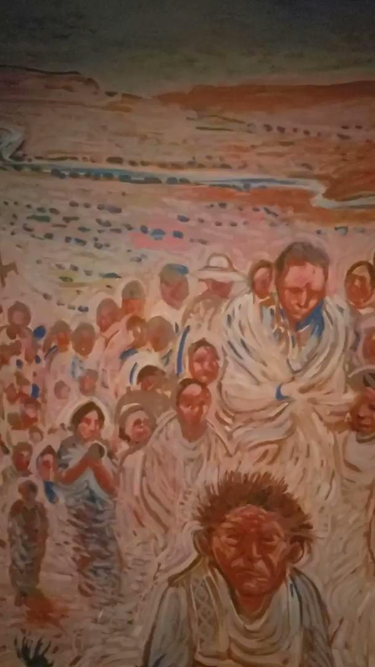
Source #6
“The Long Walk” Painting
by Shonto Begay
Bosque Redondo
Memorial Museum
Fort Sumner
Historic Site
New Mexico
Click twice to play the video
Notes:
“The Long Walk” by Shonto Begay | Video courtesy of Jeannine Kuropatkin
Bosque Redondo Memorial Museum, Fort Sumner Historic Site, NM

Slide 9
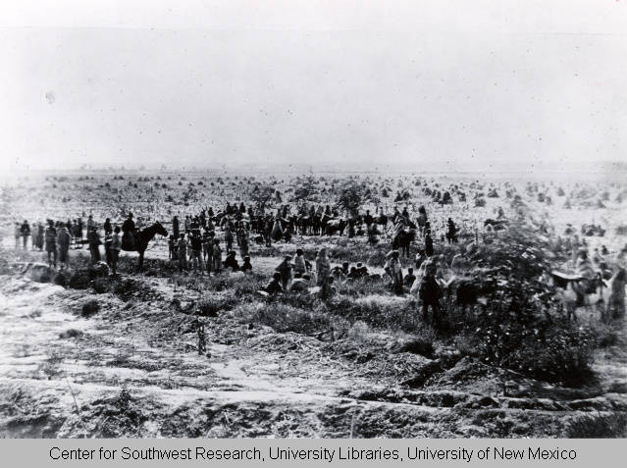
Source #7
Navajo Indians at Bosque Redondo, 1863-1867, William A. Keleher Collection
Notes:
Source: Navajo Indians at Bosque Redondo, 1863-1867, William A. Keleher Collection,
https://econtent.unm.edu/digital/collection/keleher/id/365/rec/30

Slide 10
Source #8
“I was told by my mother that people travelled to Hwééldi, and there, the people received rations of white flour. The people did not know how to prepare food with white flour so they just made flour paste. There were people who got sick from eating the white flour without cooking it. Some people also ate coffee beans without boiling them and also died from it.”
- Annabelle Benally is 75 years old and of the
Charcoal Streaked Division clan.
Notes:
Source: page 29, Oral History Stories of the Long Walk Hwéeldi Baa Hané, By The Diné of the Eastern Region of the Navajo, Reservation, Stories Collected and Recorded by the Title VII Bilingual Staff Patty Chee, Milanda Yazzie, Judy Benally, Marie Etsitty, and Bessie C. Henderson. Lake Valley Navajo School, January 1, 1991

Slide 11
Credits: Slideshow Background Evening, Navajo Country, Arizona by George Elbert Burr c. 1920’s pencil on paper Smithsonian American Art Museum
Notes:
Source: https://www.lookandlearn.com/history-images/YSA003251/Evening-Navajo-Country-Arizona

