Slide 1
¿Qué tienen todos estos lugares en común?
Notes:
ENGAGE Slideshow: There are 10 slides of important places, many of which have appeared in popular culture.

Slide 2
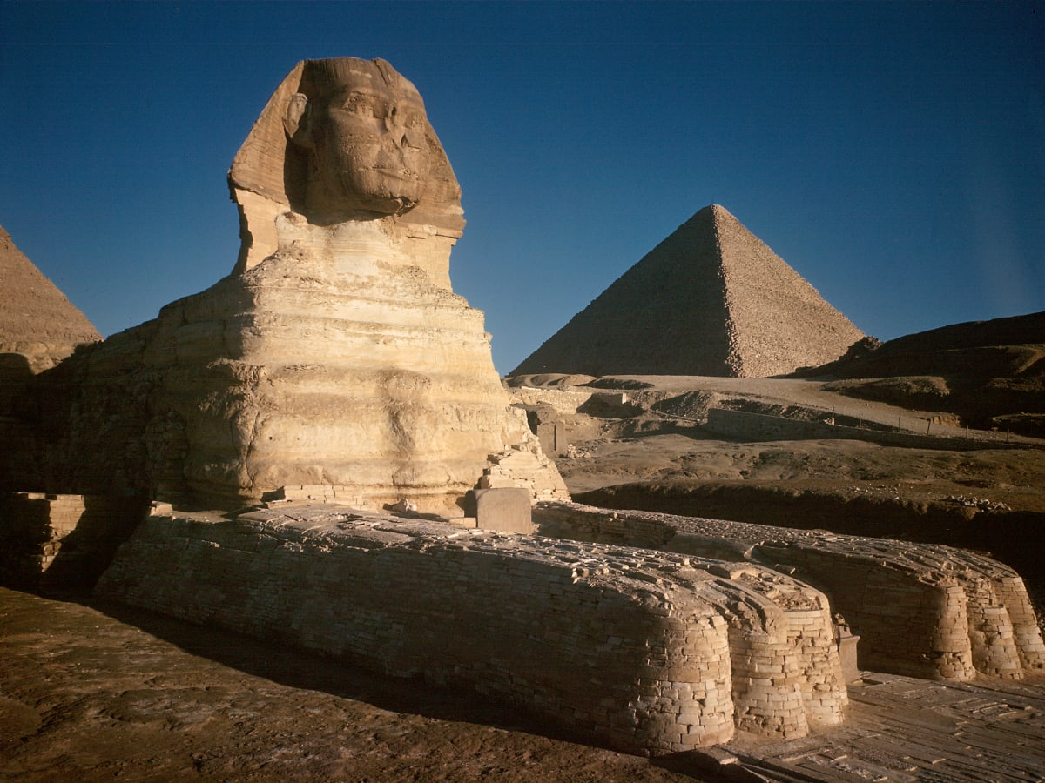
Pirámide y la Esfinge
Notes:
Pyramids & Sphinx
Left Photo: https://www.history.com/topics/ancient-egypt/the-sphinx
Theater Poster Photo: https://www.google.com/imgres?imgurl=http%3A%2F%2Fprodimage.images-bn.com%2Fpimages%2F9780061760174_p0_v11_s1200x630.jpg&imgrefurl=https%3A%2F%2Fwww.barnesandnoble.com%2Fw%2Fdeath-on-the-nile-agatha-christie%2F1013985548&tbnid=DB5DIl8dn56OvM&vet=12ahUKEwiVkNSQ2KP5AhVnsHIEHd6uAN4QMygZegUIARCUAg..i&docid=YMBpwBnQQ-1SPM&w=419&h=630&q=death%20on%20the%20nile&safe=active&ved=2ahUKEwiVkNSQ2KP5AhVnsHIEHd6uAN4QMygZegUIARCUAg

Slide 3
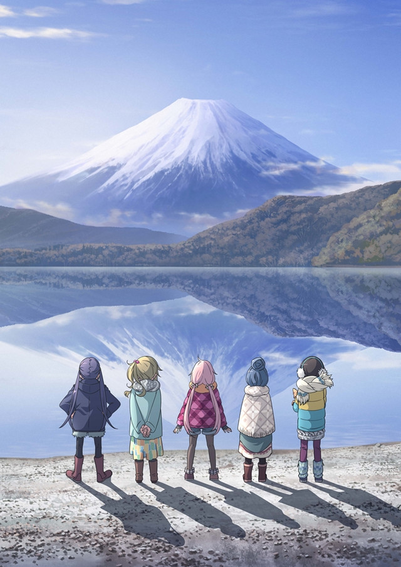
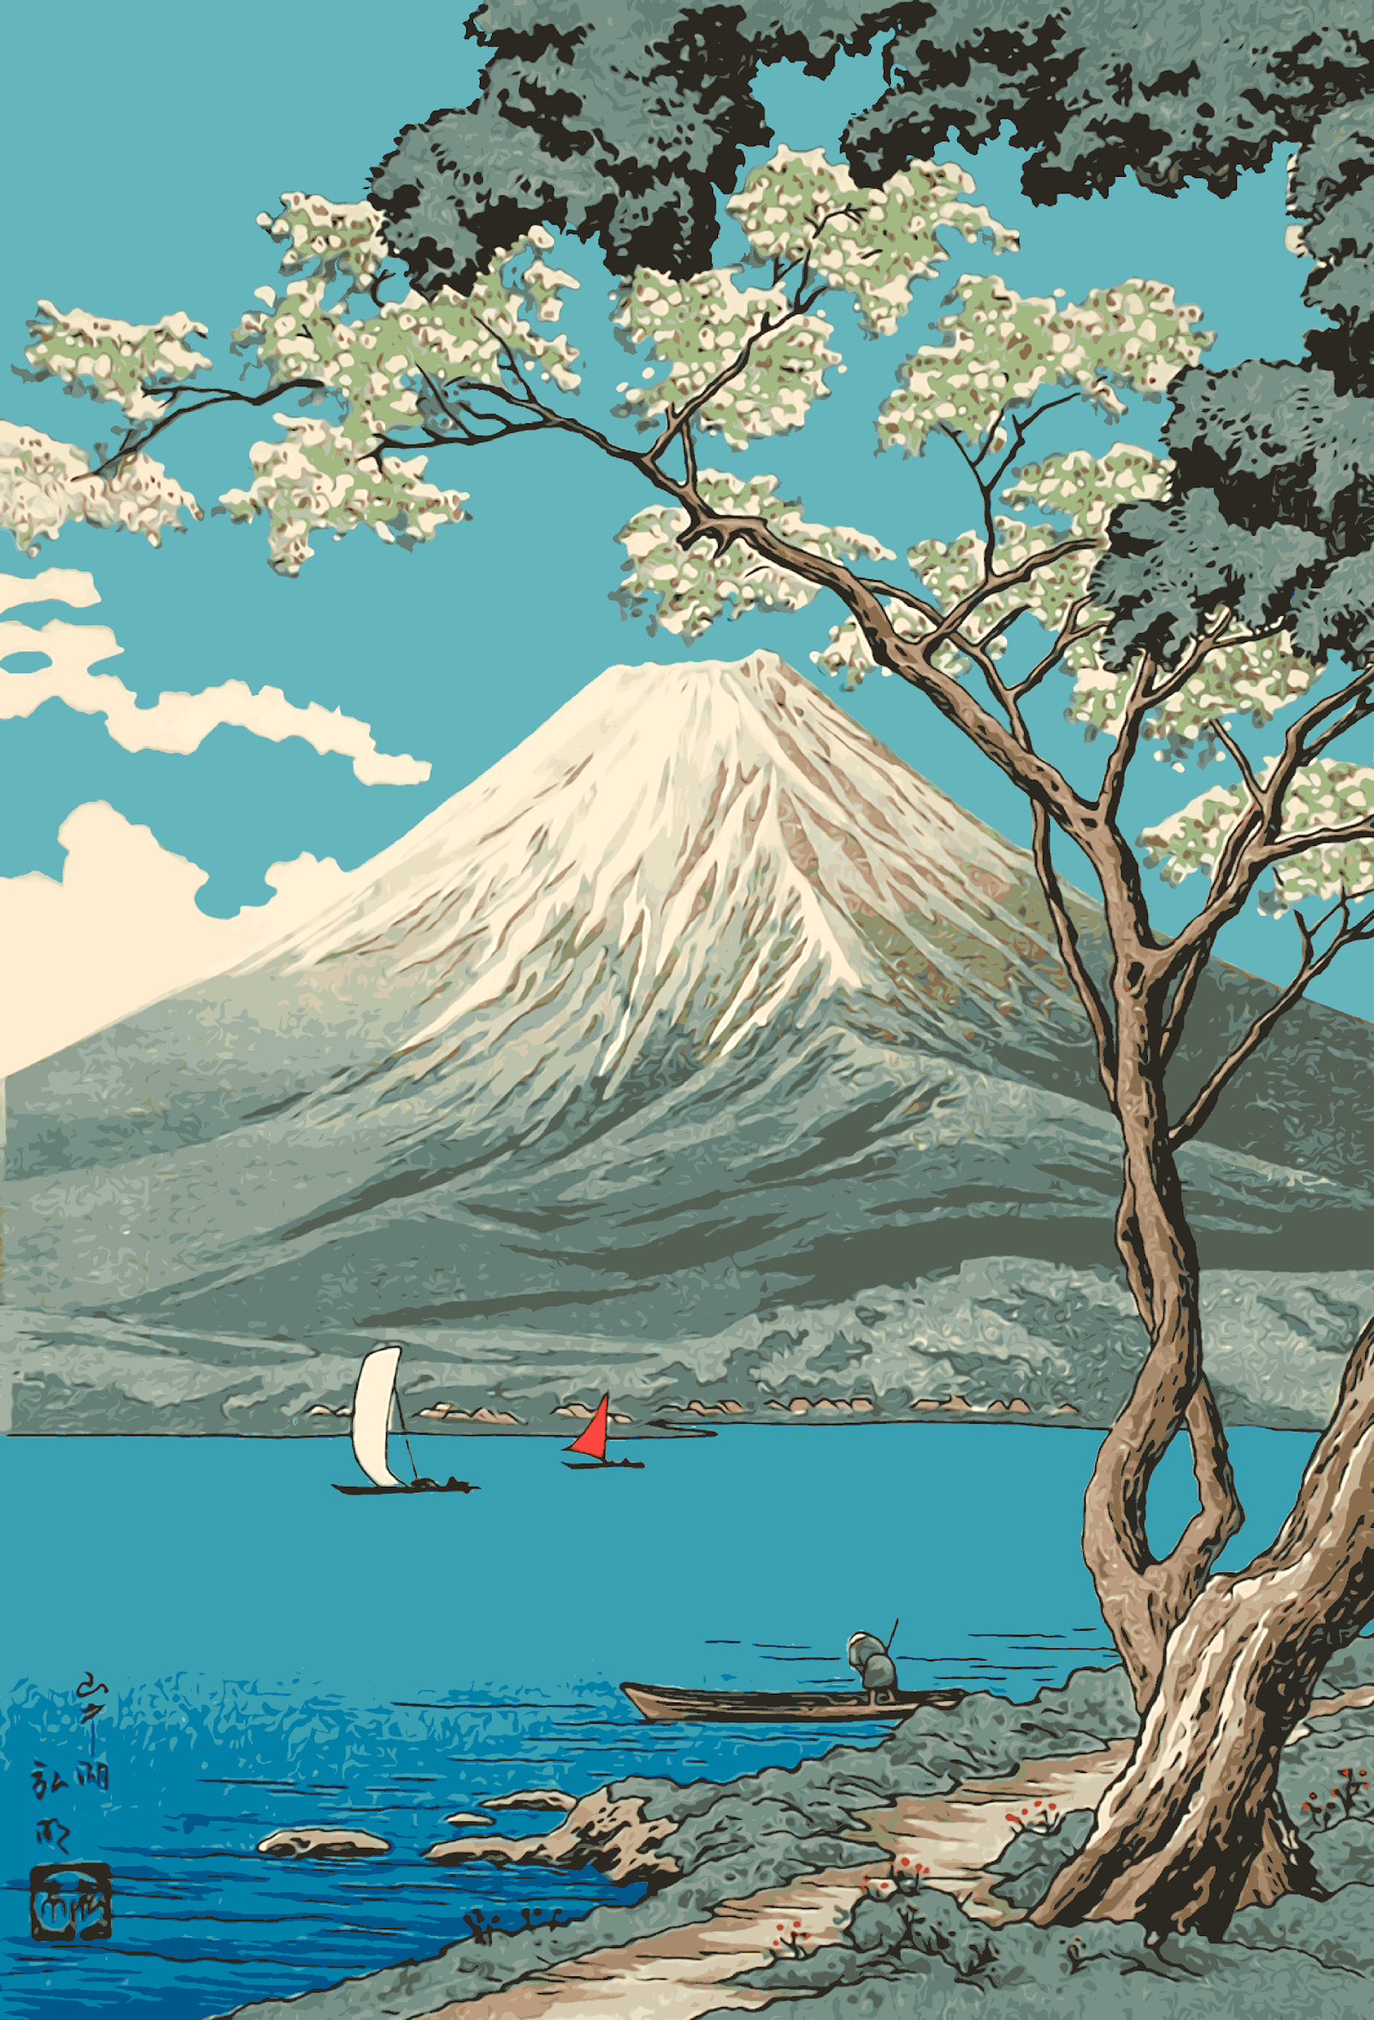
Mt. Fuji
Notes:
Mt Fuji
Photo Left: Laid Back Camp Anime & Manga http://img1.ak.crunchyroll.com/i/spire1/0091beab6cf224e1ef71b42aa3852c861498262868_full.jpg
Photo Right: Mt Fuji from Lake Yamanaka | https://collections.lacma.org/node/201436

Slide 4
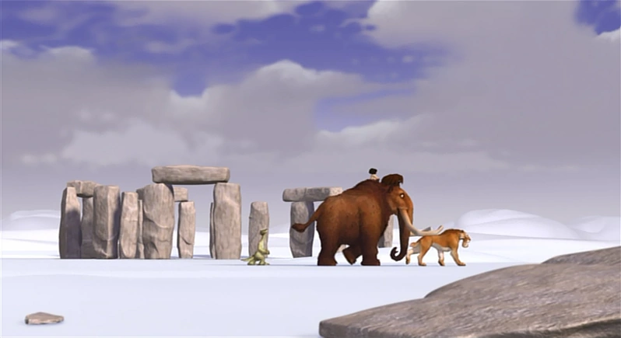
Stonehenge
Notes:
Stonehenge
Photo: https://iceage.fandom.com/wiki/Stonehenge

Slide 5
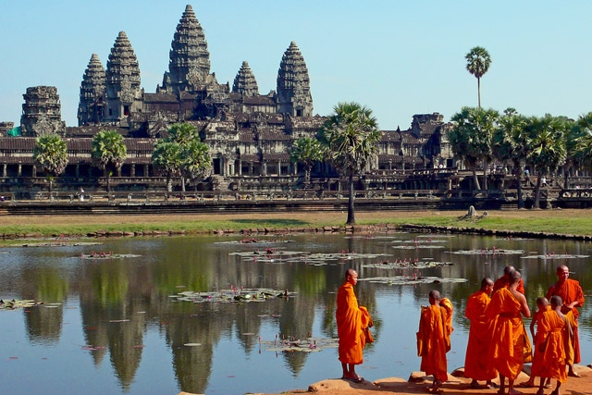
Angkor Wat
Notes:
Angkor Wat
https://asiasociety.org/sites/default/files/styles/1200w/public/A/angkorwat.jpg

Slide 6
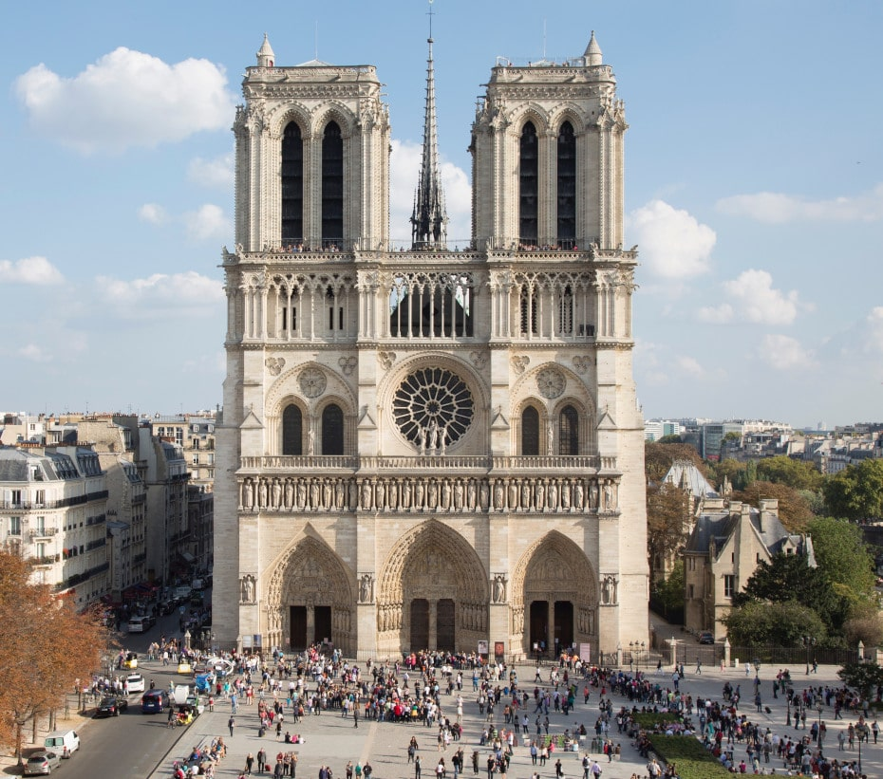
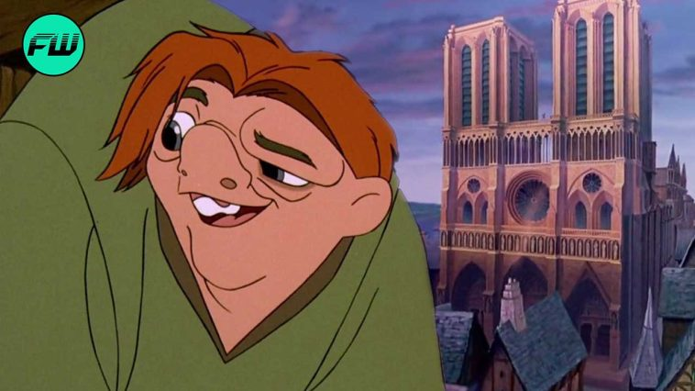
Notre Dame
Notes:
Notre Dame Cathedral
Photo Left: https://www.friendsofnotredamedeparis.org/wp-content/uploads/2022/03/Notre-Dame_facade-occidentale_parvis.jpeg
Photo Right: https://fandomwire.com/wp-content/uploads/2022/05/5-Urban-Legends-About-The-Hunchback-Of-Notre-Dame.jpg

Slide 7
¿Qué tienen todos estos lugares en común?
* Discute con tu compañero de al lado.
* Discute con tu grupo y llega a un consenso.
* Compartir en grupo

Slide 8
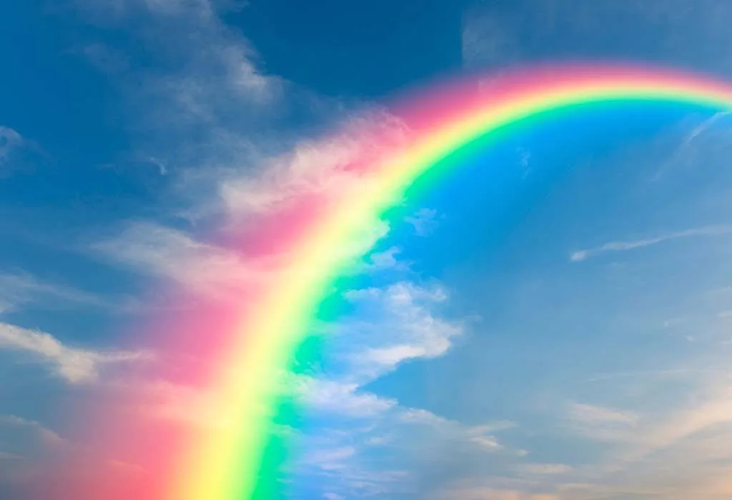
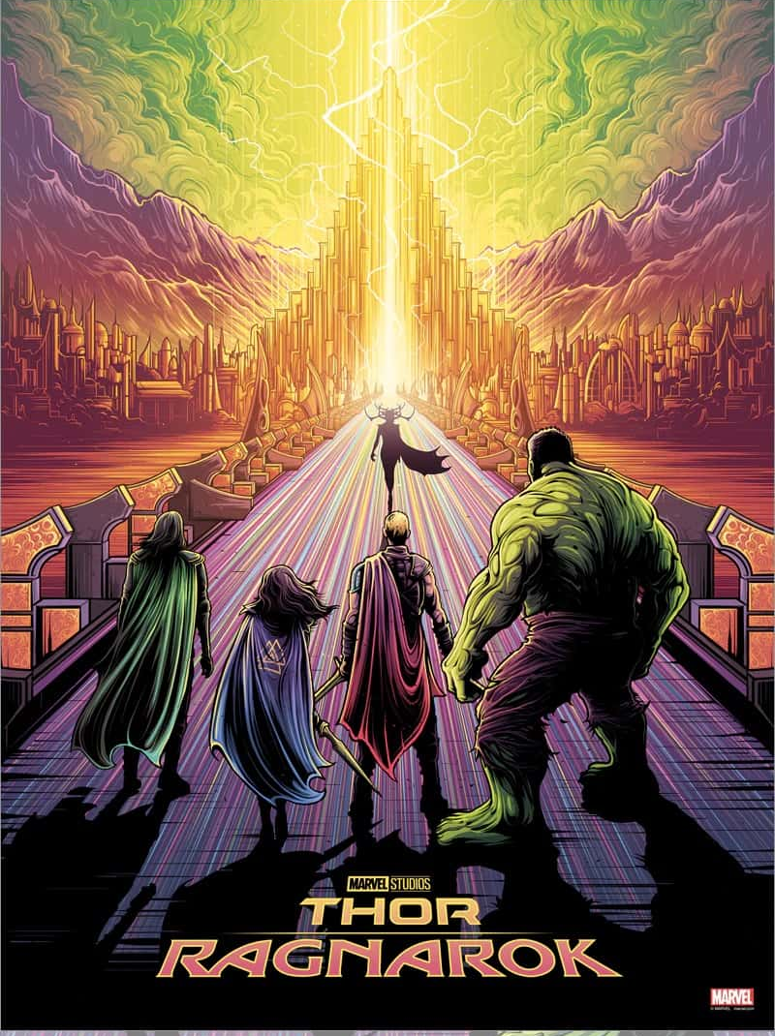
Asgard
Notes:
https://comic-watch.com/movies/thor-ragnarok-asgard-must-fall
Asgard - Land of the Gods in Norse mythology

Slide 9
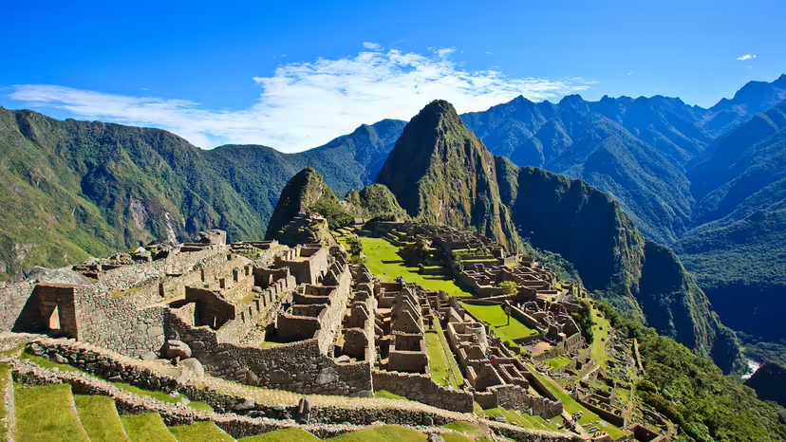
Machu Picchu
Notes:
Machu Picchu
https://media.hswstatic.com/eyJidWNrZXQiOiJjb250ZW50Lmhzd3N0YXRpYy5jb20iLCJrZXkiOiJnaWZcL21hY2h1LXBpY2NodS0xLmpwZyIsImVkaXRzIjp7InJlc2l6ZSI6eyJ3aWR0aCI6ODI4fSwidG9Gb3JtYXQiOiJhdmlmIn19

Slide 10
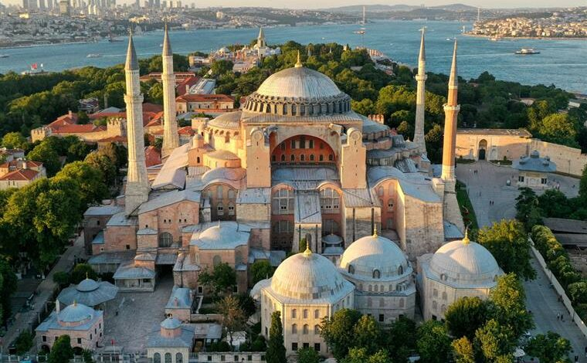
Hagia Sophia
Notes:
Hagia Sophia
Photo: https://news.artnet.com/app/news-upload/2020/07/GettyImages-1226033224.jpg

Slide 11
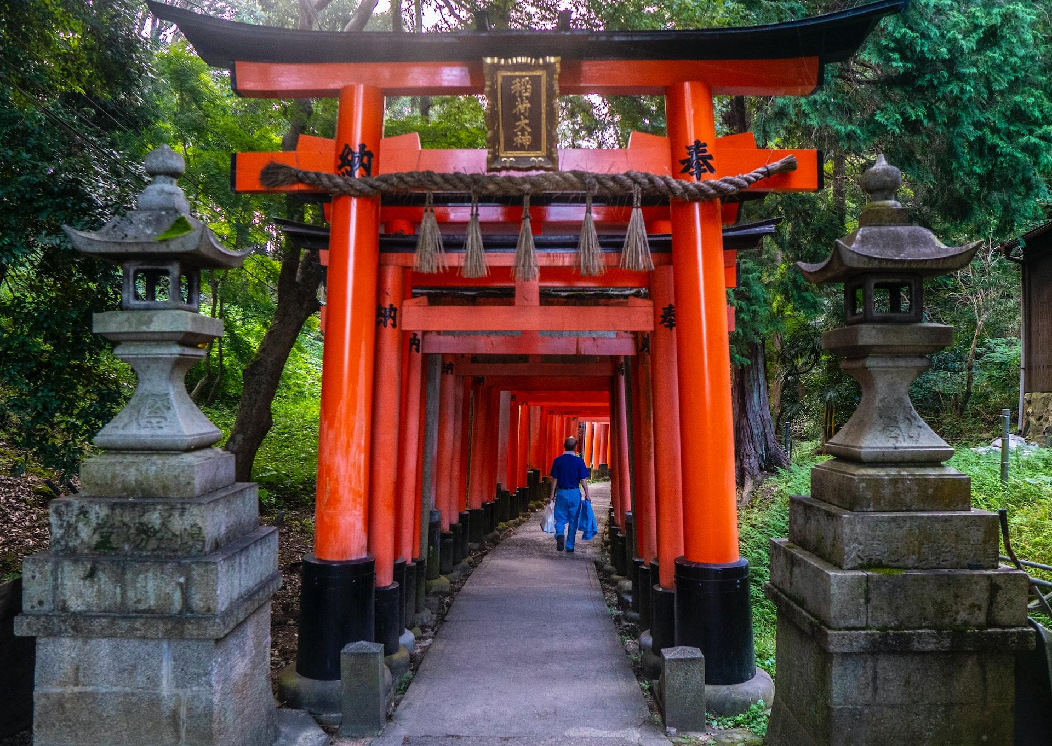
Templo Fushimi Inari
Notes:
Photo by Shai Pal on Unsplash | Torii Gates of Fushimi Inari Temple, Kyoto, Japan

Slide 12
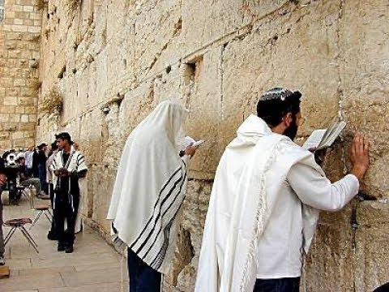
muro Occidental
Notes:
Western Wall
Photo: https://i.ytimg.com/vi/JdD96houek4/hqdefault.jpg

Slide 13
¿Qué tienen todos estos lugares en común?
* Discute con tu compañero de al lado.
* Discute con tu grupo y llega a un consenso.
* Compartir en grupo

